Slide 1
CHAPTER 3
MATLAB BASICS

Slide 2
WHAT WILL WE LEARN?
What is MATLAB?
What programming environment does MATLAB offer?
What are M-files?
What is the difference between MATLAB scripts and functions?
How can I get started with MATLAB?

Slide 3
Introduction to Matlab
MATLAB = MATrix LABoratory
Rich sets of specialized functions—encapsulated in toolboxes
MATLAB documentation:
Command line help
http://www.mathworks.com

Slide 4
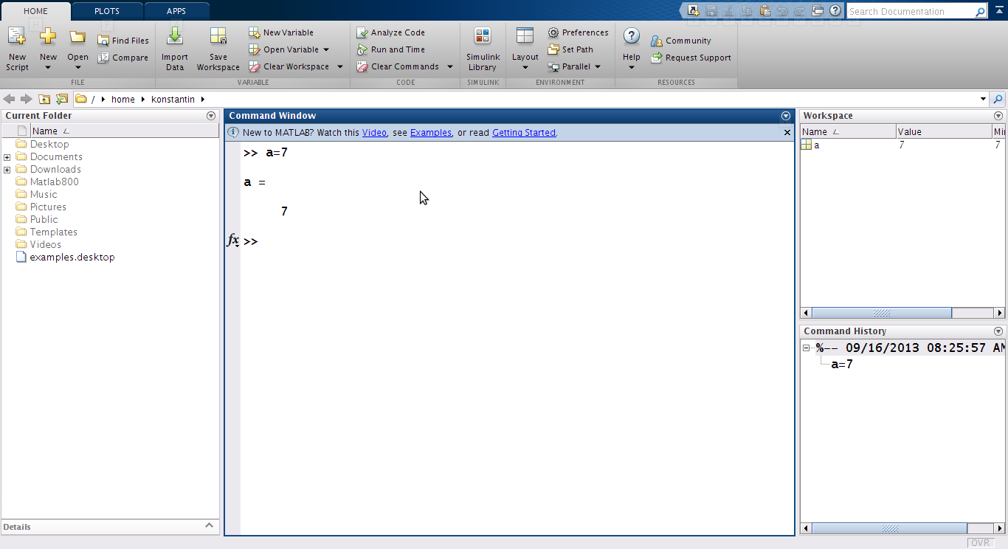
MATLAB R2013b Environment

Slide 5
MATLAB Data Types
MATLAB’s basic data type is the matrix (or array).
All data are considered to be matrices
Single values are considered by MATLAB to be 1×1 matrices.

Slide 6
MATLAB Data Class
uint8 8-Bit unsigned integers
uint16 16-Bit unsigned integers
uint32 32-Bit unsigned integers
int8 8-Bit signed integers
int16 16-Bit signed integers
int32 32-Bit signed integers
single Single-precision floating numbers (4 bytes)
double Double-precision floating numbers (8 bytes)
logical Values are 0 (false) or 1 (true) (1 bytes)
char Characters (2 bytes)

Slide 7
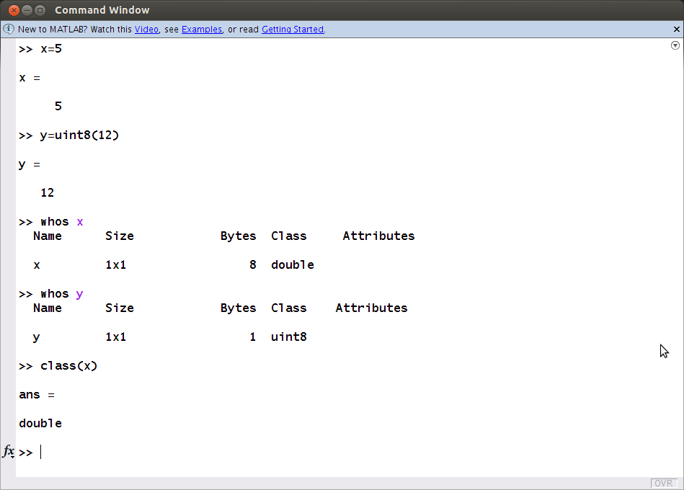
class(), whos

Slide 8
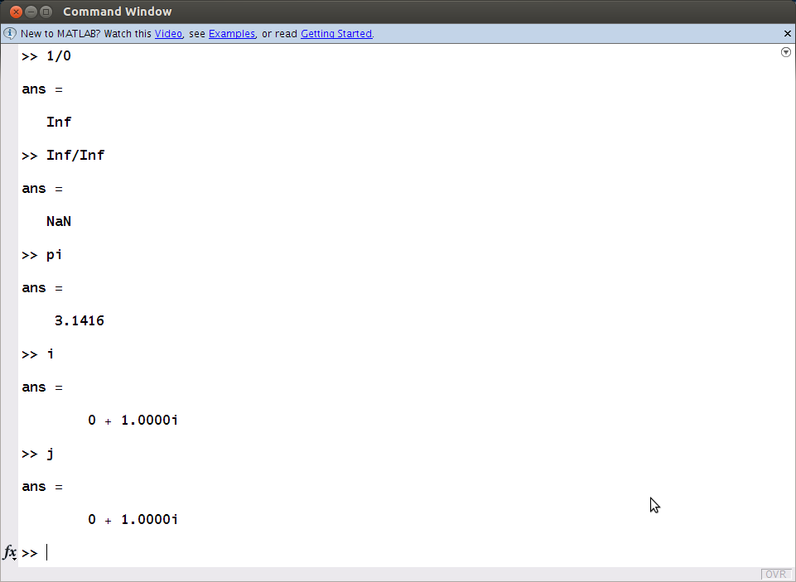
Some Constants
and Variables
Inf
NaN
pi
ans
eps
i
j

Slide 9
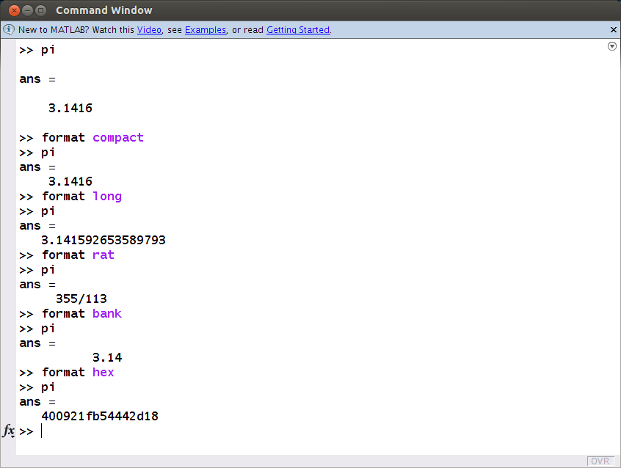
Display format
compact/loose
long/short
longE
rat
hex
bank
...

Slide 10
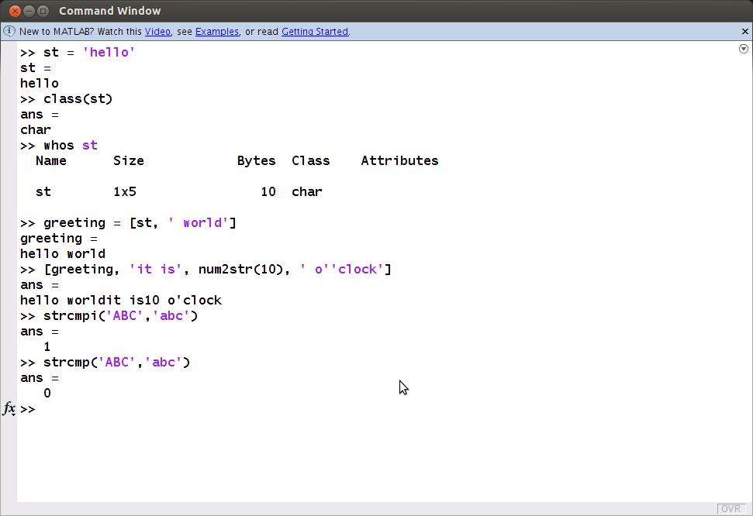
Strings are 1xn arrays of char

Slide 11
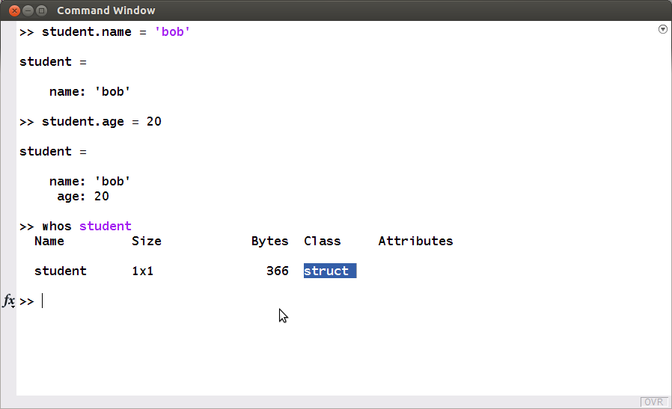
Structures

Slide 12
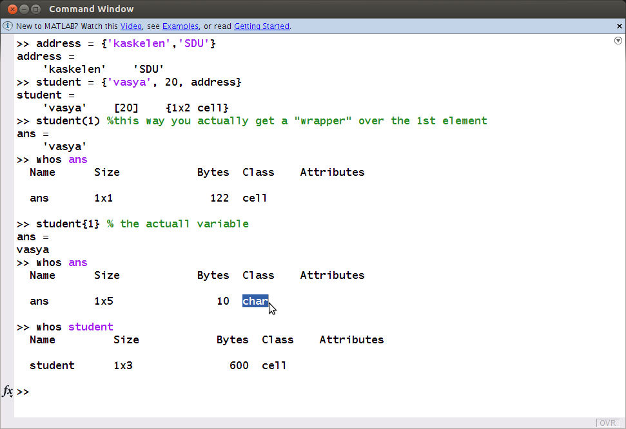
Cell Arrays

Slide 13
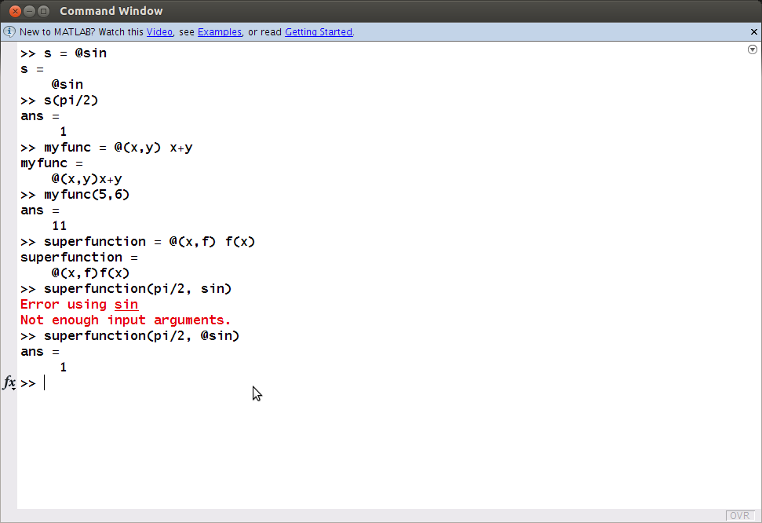
Function Handles
similar to
function pointers in C/C++
delegates in C#

Slide 14
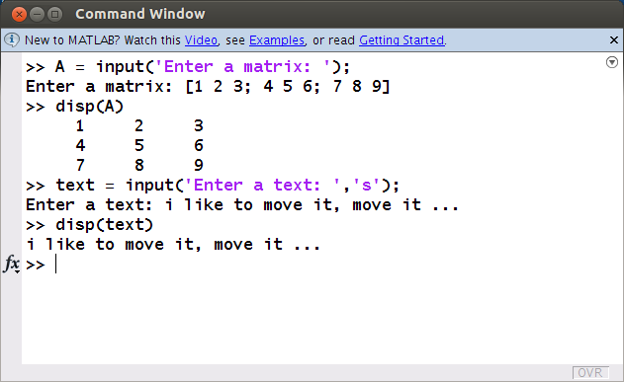
input, disp

Slide 15
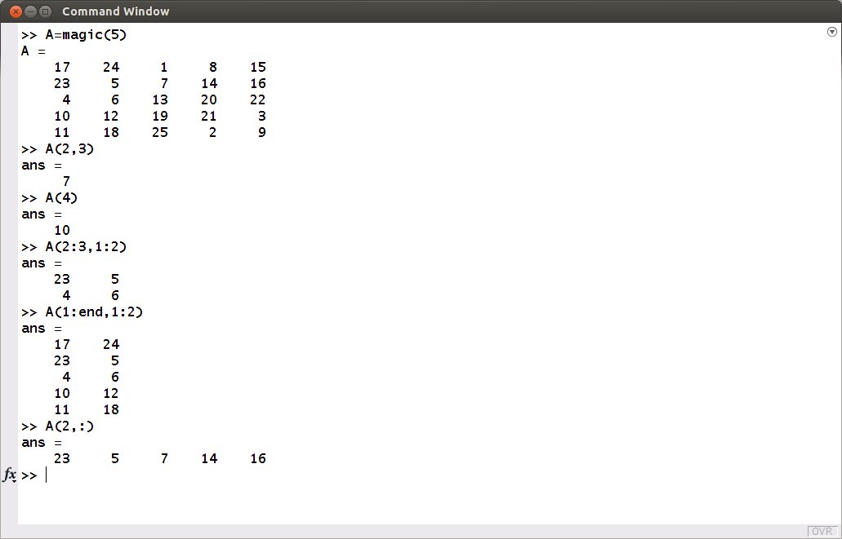
Array and Matrix
Indexing and Slicing

Slide 16
Standard Arrays
zeros(m,n) creates an m × n matrix of zeros.
ones(m,n) creates an m × n matrix of ones.
true(m,n) creates an m × n matrix of logical ones.
false(m,n) creates an m × n matrix of logical zeros.
eye(n) returns an n × n identity matrix.
magic(m) returns a magic square2 of order m.
rand(m,n) creates an m × n matrix whose entries are pseudorandom numbers uniformly distributed in the interval [0, 1].
randn(m,n) creates an m × n matrix whose entries are pseudorandom numbers that follow a normal (i.e., Gaussian) distribution with mean 0 and variance 1.

Slide 17
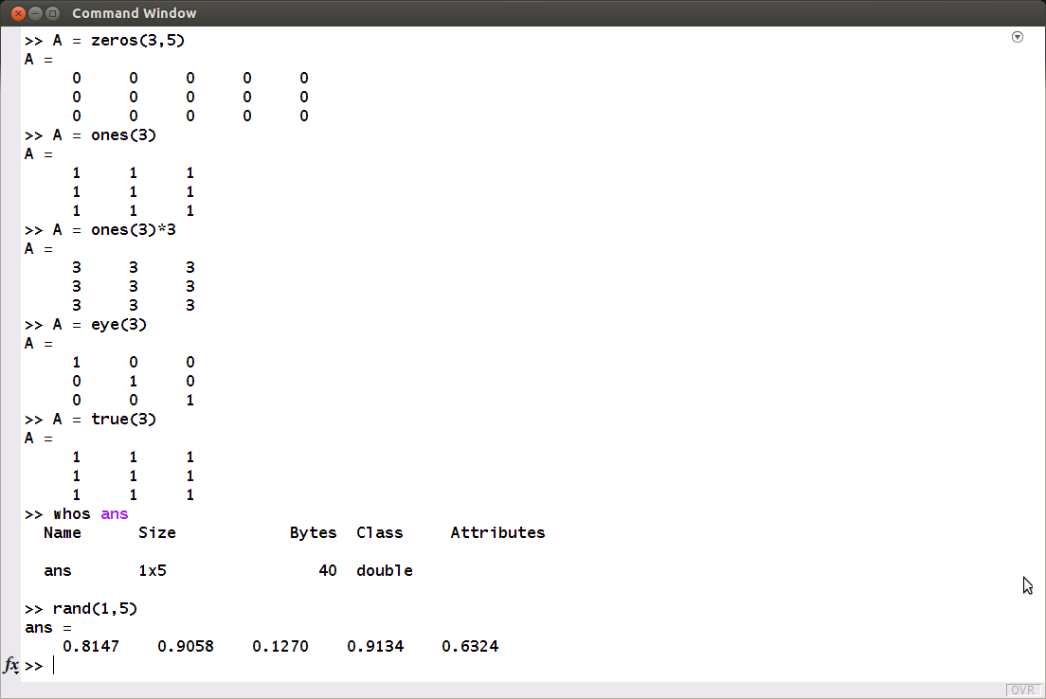
zeros, ones, eye, true, rand ...

Slide 18
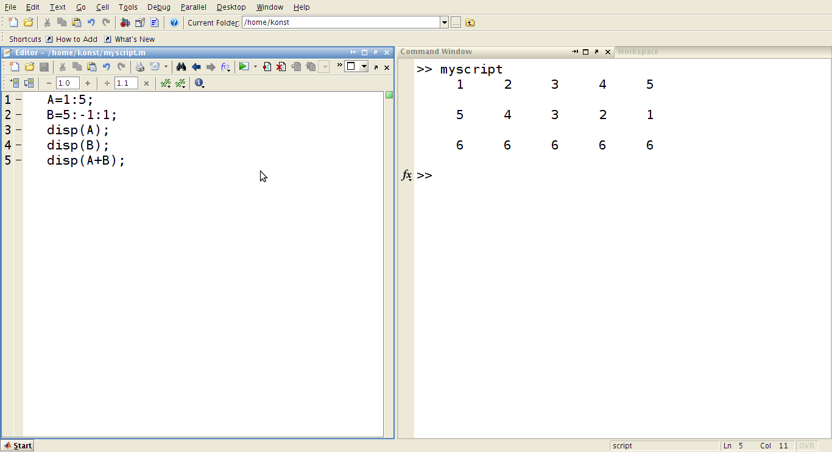
M-file (script)

Slide 19
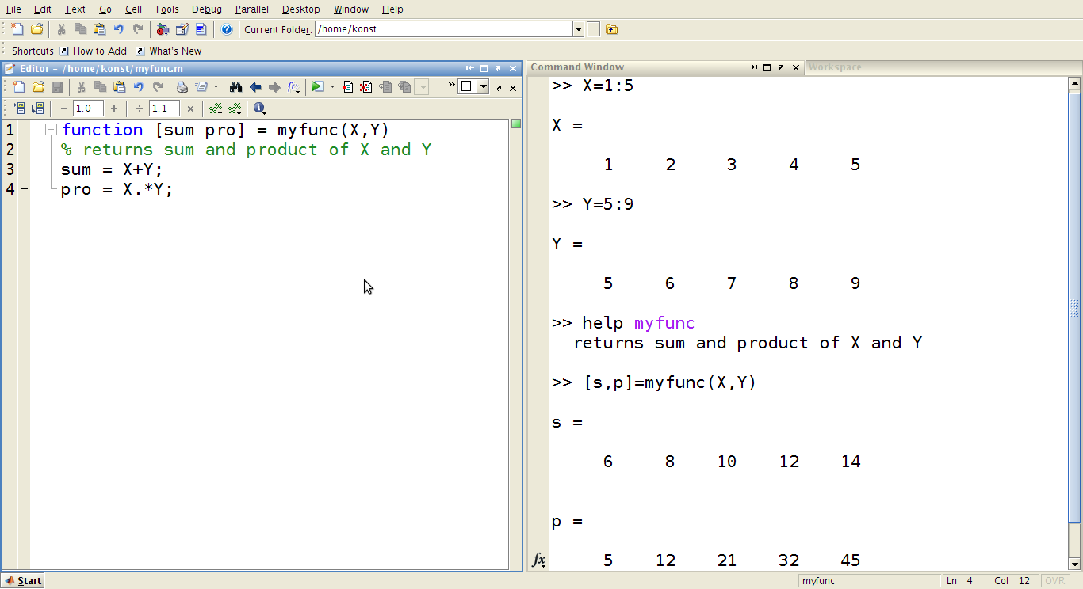
M-file (function)

Slide 20
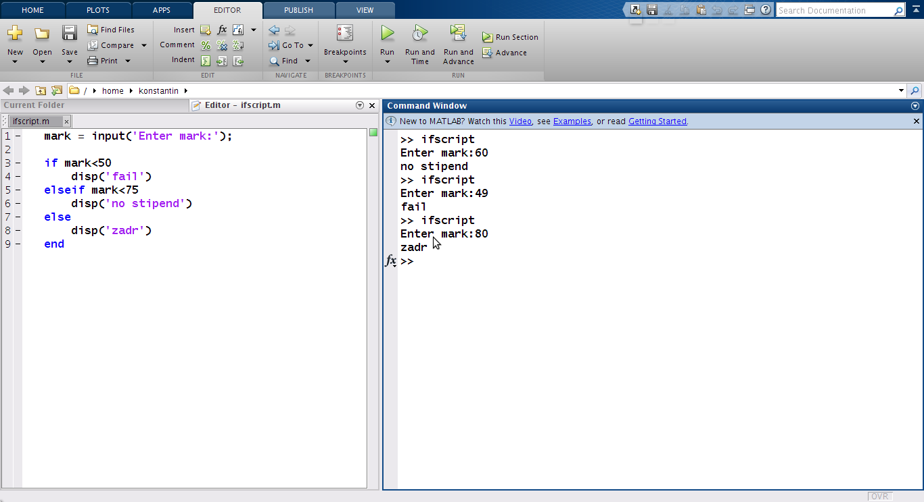
if … [elseif …] [else …] end

Slide 21
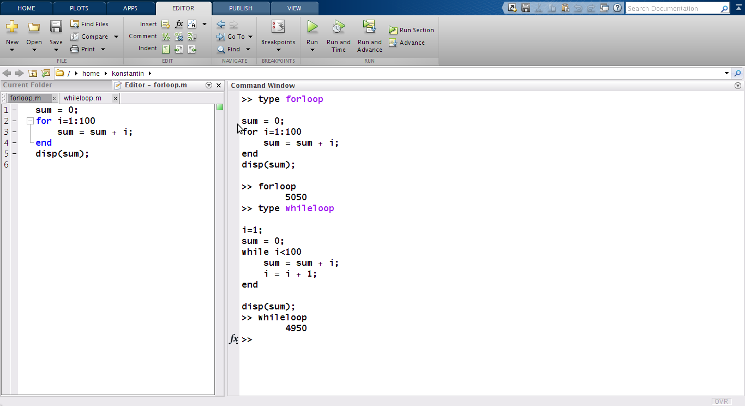
for/while ... end

Slide 22
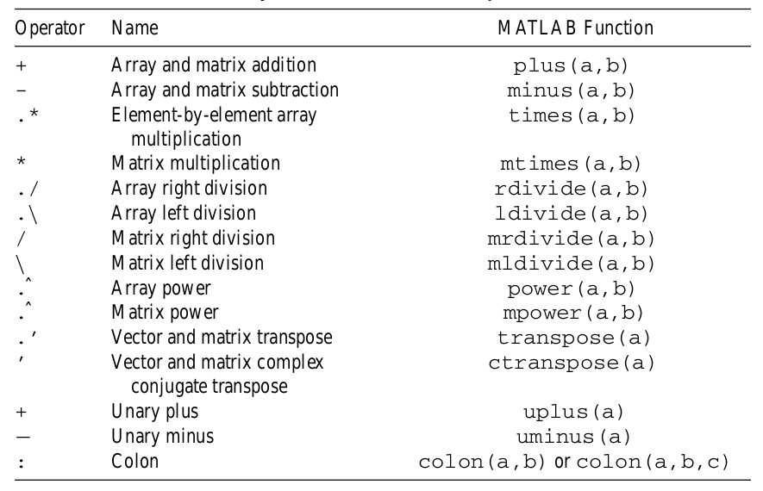
Arithmetic Operations

Slide 23
Exercises:
1. Perform matrix multiplication on two matrices.
X = [1 2 -2; 0 -3 4; 7 3 0]
Y = [1 0 -1; 2 3 -5; 1 3 5]
X * Y
2. Perform element-by-element multiplication.
X .* Y
3. Perform another matrix multiplication on two matrices.
X = eye(3,4)
Y = rand(4,2)
X * Y
Y * X

Slide 24
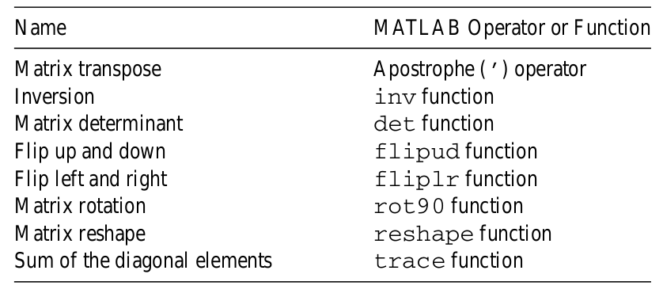
Specialized Matrix Operations

Slide 25
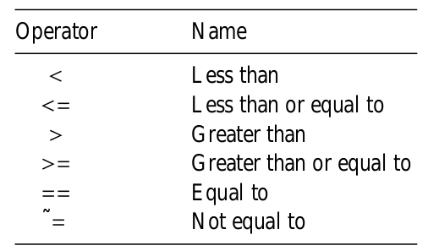
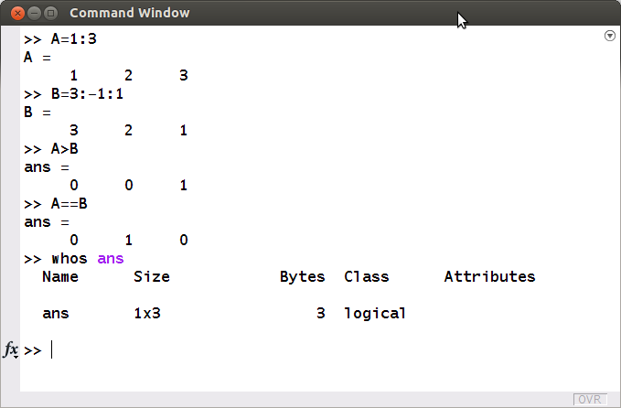
Relational Operators

Slide 26
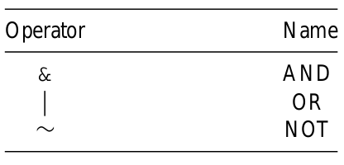
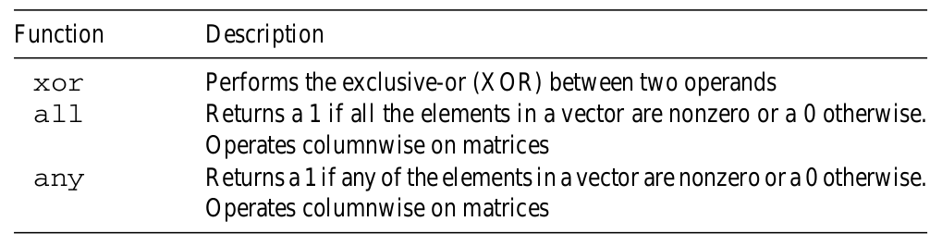
Logical Operators and Logical Functions

Slide 27
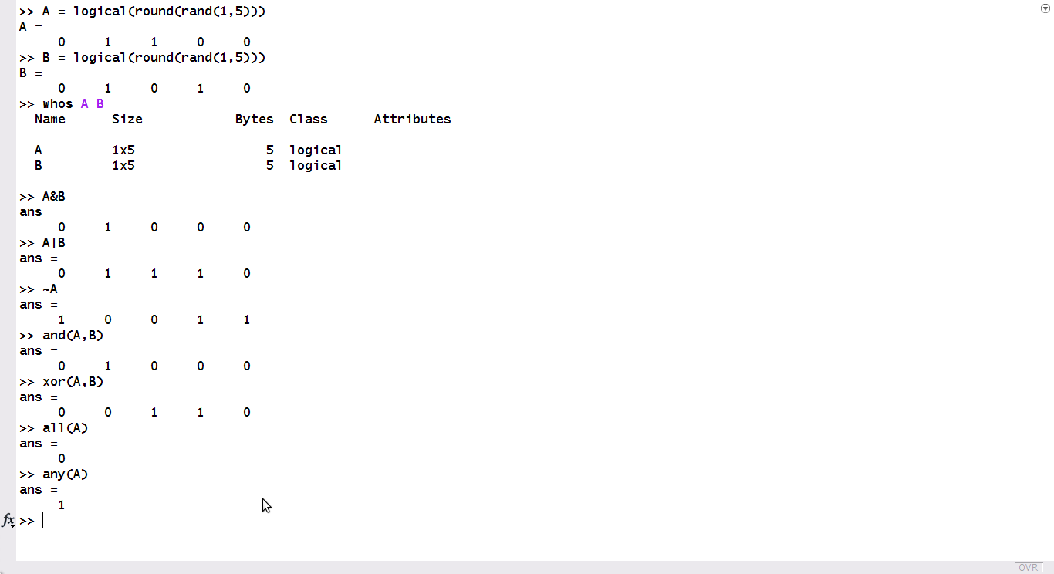
Logical Operators and Logical Functions

Slide 28
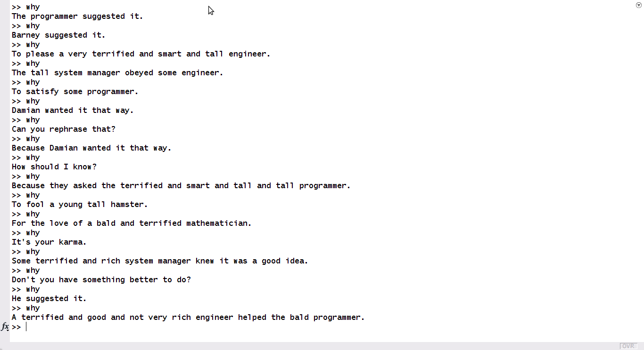
Fun in MATLAB

Slide 29
Homework
● Exercises in the end of Chapter 3 of textbook.

